Slide 1
A FLEXIBLE E-MAIL CLIENT APP
Rishittha MJ | - | 711222243044
Roobika R | - | 711222243047
Rithya M | - | 711222243045
Sharmila G | - | 711222243050
Sowmiya K | - | 711222243053

Slide 2
DESCRIPTION
Flexible e-mail Client App is an ultimate solution for managing your email accounts with ease, efficiency, and customization. With a user-friendly interface, our email client lets you stay productive and in control of your communications. Stay connected, stay organized, and experience e-mail management.
Multi-Account Support: Seamlessly manage multiple email accounts from different providers (e.g., Gmail, Outlook, Yahoo) in one unified interface, allowing for quick switching and efficient handling of all your communications.
Customizable Interface: Tailor the app’s layout, theme, and notification settings to suit your personal preferences, offering a more personalized and comfortable user experience.
Advanced Search & Filters: Quickly find emails with powerful search capabilities, including advanced filters for date, sender, subject, and keywords, making it easy to locate specific messages even in a crowded inbox.
Offline Access & Syncing: Access your emails and compose new messages offline, with automatic syncing once an internet connection is available, ensuring you stay productive even when offline.
The app simulates a messaging interface, allowing the user to send and receive messages, and view a history of previous messages.
It showcases some of the key features of the Compose UI toolkit, data management, and user interactions

Slide 3
Main Activity.kt:
package com.example.emailapplication
import android.annotation.SuppressLint
import android.content.Context
import android.content.Intent
import android.os.Bundle
import androidx.activity.ComponentActivity
import androidx.activity.compose.setContent
import androidx.compose.foundation.layout.*
import androidx.compose.material.*
import androidx.compose.runtime.*
import androidx.compose.ui.Alignment
import androidx.compose.ui.Modifier
import androidx.compose.ui.graphics.Color
import androidx.compose.ui.platform.LocalContext
import androidx.compose.ui.text.TextStyle
import androidx.compose.ui.text.font.FontWeight
import androidx.compose.ui.text.style.TextAlign
import androidx.compose.ui.tooling.preview.Preview
import androidx.compose.ui.unit.dp
import androidx.compose.ui.unit.sp
import com.example.emailapplication.ui.theme.EmailApplicationTheme

Slide 4
LoginActivity.kt
class SendMailActivity : ComponentActivity() {
private lateinit var databaseHelper: EmailDatabaseHelper
@SuppressLint("UnusedMaterialScaffoldPaddingParameter")
override fun onCreate(savedInstanceState: Bundle?) {
super.onCreate(savedInstanceState)
databaseHelper = EmailDatabaseHelper(this)
setContent {
Scaffold(topBar = { TopAppBar(backgroundColor = Color(0xFFadbef4), modifier = Modifier.height(80.dp),title = { Text(text = "Send Mail", fontSize = 32.sp, color = Color.Black, modifier = Modifier.fillMaxWidth(),textAlign = TextAlign.Center,)
})}
) {
openEmailer(this,databaseHelper)
}}}}
@Composable
fun openEmailer(context: Context, databaseHelper: EmailDatabaseHelper) {
var recevierMail by remember {mutableStateOf("") }
var subject by remember {mutableStateOf("") }
var body by remember {mutableStateOf("") }
var error by remember { mutableStateOf("") }
val ctx = LocalContext.current
Column(modifier = Modifier.fillMaxSize().padding(top = 55.dp, bottom = 25.dp, start = 25.dp, end = 25.dp) horizontalAlignment = Alignment.Start){Text(text = "Receiver Email-Id",fontWeight = FontWeight.Bold,fontSize = 16.sp)

Slide 5
TextField(value = body, onValueChange = { body = it }, onValueChange = { body = it }, placeholder = { Text(text = "Body") }, modifier = Modifier.padding(16.dp) .fillMaxWidth(),textStyle = TextStyle(color = Color.Black, fontSize = 15.sp),singleLine = true )
Spacer(modifier = Modifier.height(20.dp))
Button(onClick = {
if( recevierMail.isNotEmpty() && subject.isNotEmpty() && body.isNotEmpty()) {
val email = Email(
id = null,
recevierMail = recevierMail,
subject = subject,
body = body)
databaseHelper.insertEmail(email)
error = "Mail Saved"
} else {
error = "Please fill all fields"
}
val i = Intent(Intent.ACTION_SEND)
val emailAddress = arrayOf(recevierMail)
i.putExtra(Intent.EXTRA_EMAIL,emailAddress)
i.putExtra(Intent.EXTRA_SUBJECT,subject)
i.putExtra(Intent.EXTRA_TEXT,body)
i.setType("message/rfc822")
ctx.startActivity(Intent.createChooser(i,"Choose an Email client : "))

Slide 6
},
colors = ButtonDefaults.buttonColors(backgroundColor = Color(0xFFd3e5ef))
) {
Text(
text = "Send Email",
modifier = Modifier.padding(10.dp),
color = Color.Black,
fontSize = 15.sp
)}}}
Main Activity.kt
class MainActivity : ComponentActivity() {
override fun onCreate(savedInstanceState: Bundle?) {
super.onCreate(savedInstanceState)
setContent {
Surface(
modifier = Modifier.fillMaxSize().background(Color.White),
) {
Email(this)
}}}}
@Composable
fun Email(context: Context) {
Text( text = "Home Screen",modifier = Modifier.padding(top = 74.dp, start = 100.dp, bottom = 24.dp), color = Color.Black, fontWeight = FontWeight.Bold fontSize = 32.sp)

Slide 7
Column(
horizontalAlignment = Alignment.CenterHorizontally,
verticalArrangement = Arrangement.Center
) {
Image(
painterResource(id = R.drawable.home_screen), contentDescription = "")
Button(onClick = {
context.startActivity(
Intent( context,
SendMailActivity::class.java
))},
colors = ButtonDefaults.buttonColors(backgroundColor = Color(0xFFadbef4))
) {
Text(
text = "Send Email", modifier = Modifier.padding(10.dp), color = Color.Black, fontSize = 15.sp,)}
Spacer(modifier = Modifier.height(20.dp))
Button(onClick = {
context.startActivity(
Intent(
context,
ViewMailActivity::class.java
))},
colors = ButtonDefaults.buttonColors(backgroundColor = Color(0xFFadbef4))
) {
Text(
text = "View Emails",
modifier = Modifier.padding(10.dp),
color = Color.Black,
fontSize = 15.sp
)}}}

Slide 8
RegisterActivity.kt
class RegisterActivity : ComponentActivity() {
private lateinit var databaseHelper: UserDatabaseHelper
override fun onCreate(savedInstanceState: Bundle?) {
super.onCreate(savedInstanceState)
databaseHelper = UserDatabaseHelper(this)
setContent {
RegistrationScreen(this, databaseHelper)
}
}
@Composable
fun RegistrationScreen(context: Context, databaseHelper: UserDatabaseHelper) {
var username by remember { mutableStateOf("") }
var password by remember { mutableStateOf("") }
var email by remember { mutableStateOf("") }
var error by remember { mutableStateOf("") }
Column(
modifier = Modifier.fillMaxSize().background(Color.White),
horizontalAlignment = Alignment.CenterHorizontally,
verticalArrangement = Arrangement.Center
) {
Image(
painterResource(id = R.drawable.email_signup), contentDescription = "",
modifier = Modifier.height(300.dp)
)
Text(
fontSize = 36.sp, fontWeight = FontWeight.ExtraBold,
fontFamily = FontFamily.Cursive, text = "Register"
)

Slide 9
Spacer(modifier = Modifier.height(10.dp))
TextField(
value = username, onValueChange = { username = it },
label = { Text("Username") },
modifier = Modifier.padding(10.dp) .width(280.dp))
TextField(
value = email, onValueChange = { email = it },
label = { Text("Email") },
modifier = Modifier
.padding(10.dp)
.width(280.dp)
)
TextField(
value = password,
onValueChange = { password = it },label = { Text("Password") },
visualTransformation = PasswordVisualTransformation(),
modifier = Modifier.padding(10.dp) .width(280.dp))
if (error.isNotEmpty()) {
Text(
text = error,
color = MaterialTheme.colors.error,
modifier = Modifier.padding(vertical = 16.dp)
)}

Slide 10
Button(
onClick = {
if (username.isNotEmpty() && password.isNotEmpty() && email.isNotEmpty()) {
val user = User(id = null, firstName = username, lastName = null, email = email, password = password
databaseHelper.insertUser(user)
error = "User registered successfully"
context.startActivity(
Intent(
context,
LoginActivity::class.java
)
)
} else {
error = "Please fill all fields"
}
},
colors = ButtonDefaults.buttonColors(backgroundColor = Color(0xFFd3e5ef)),
modifier = Modifier.padding(top = 16.dp)
) {
Text(text = "Register")
}
Spacer(modifier = Modifier.width(10.dp))
Spacer(modifier = Modifier.height(10.dp))

Slide 11
Row() {
Text(
modifier = Modifier.padding(top = 14.dp), text = "Have an account?"
)
TextButton(onClick = {
context.startActivity(
Intent(
context,
LoginActivity::class.java
))
})
{
Spacer(modifier = Modifier.width(10.dp))
Text(color = Color(0xFF31539a),text = "Log in")
}}}}
private fun startLoginActivity(context: Context) {
val intent = Intent(context, LoginActivity::class.java)
ContextCompat.startActivity(context, intent, null)
}

Slide 12
SendMailActivity.kt
class SendMailActivity : ComponentActivity() {
private lateinit var databaseHelper: EmailDatabaseHelper
@SuppressLint("UnusedMaterialScaffoldPaddingParameter")
override fun onCreate(savedInstanceState: Bundle?) {
super.onCreate(savedInstanceState)
databaseHelper = EmailDatabaseHelper(this)
setContent {
Scaffold(
topBar = {
TopAppBar(backgroundColor = Color(0xFFadbef4), modifier = Modifier.height(80.dp),
title = {
Text(text = "Send Mail", fontSize = 32.sp, color = Color.Black,
modifier = Modifier.fillMaxWidth(),
textAlign = TextAlign.Center,
)})}
) {
openEmailer(this,databaseHelper)
}}}}
@Composable
fun openEmailer(context: Context, databaseHelper: EmailDatabaseHelper) {
var recevierMail by remember {mutableStateOf("") }
var subject by remember {mutableStateOf("") }
var body by remember {mutableStateOf("") }
var error by remember { mutableStateOf("") }
val ctx = LocalContext.current
Column(
modifier = Modifier.fillMaxSize() .padding(top = 55.dp, bottom = 25.dp, start = 25.dp, end = 25.dp),
horizontalAlignment = Alignment.Start
) {

Slide 13
Text(text = "Receiver Email-Id",
fontWeight = FontWeight.Bold,
fontSize = 16.sp)
TextField(
value = recevierMail,
onValueChange = { recevierMail = it },
label = { Text(text = "Email address") },
placeholder = { Text(text = "abc@gmail.com") },
modifier = Modifier
.padding(16.dp)
.fillMaxWidth(),
textStyle = TextStyle(color = Color.Black, fontSize = 15.sp),)
Spacer(modifier = Modifier.height(10.dp))
Text(text = "Mail Subject",
fontWeight = FontWeight.Bold,
fontSize = 16.sp).
TextField(
value = subject,
onValueChange = { subject = it },
placeholder = { Text(text = "Subject") },
modifier = Modifier
.padding(16.dp)
.fillMaxWidth(),
textStyle = TextStyle(color = Color.Black, fontSize = 15.sp), singleLine = true,
)
Spacer(modifier = Modifier.height(10.dp)) Text(text = "Mail Body",
fontWeight = FontWeight.Bold,
fontSize = 16.sp) TextField(
value = body,
onValueChange = { body = it },
placeholder = { Text(text = "Body") },

Slide 14
modifier = Modifier
.padding(16.dp)
.fillMaxWidth(),
textStyle = TextStyle(color = Color.Black, fontSize = 15.sp),
singleLine = true,
)
Spacer(modifier = Modifier.height(20.dp))
Button(onClick = {
if( recevierMail.isNotEmpty() && subject.isNotEmpty() && body.isNotEmpty()) {
val email = Email(
id = null,
recevierMail = recevierMail,
subject = subject, body = body
)
databaseHelper.insertEmail(email)
error = "Mail Saved"
} else {
error = "Please fill all fields"
} val i = Intent(Intent.ACTION_SEND)
val emailAddress = arrayOf(recevierMail)
i.putExtra(Intent.EXTRA_EMAIL,emailAddress)
i.putExtra(Intent.EXTRA_SUBJECT,subject)
i.putExtra(Intent.EXTRA_TEXT,body)
i.setType("message/rfc822")
ctx.startActivity(Intent.createChooser(i,"Choose an Email client : "))
},

Slide 15
colors = ButtonDefaults.buttonColors(backgroundColor = Color(0xFFd3e5ef))
) {
Text(
text = "Send Email",
modifier = Modifier.padding(10.dp),
color = Color.Black,
fontSize = 15.sp
)}}}
buildscript {
ext {
compose_ui_version = '1.7.5'
}
plugins {
id 'com.android.application' version '8.7.2' apply false
id 'com.android.library' version '8.7.2' apply false
id 'org.jetbrains.kotlin.android' version '1.7.0' apply false
}

Slide 16
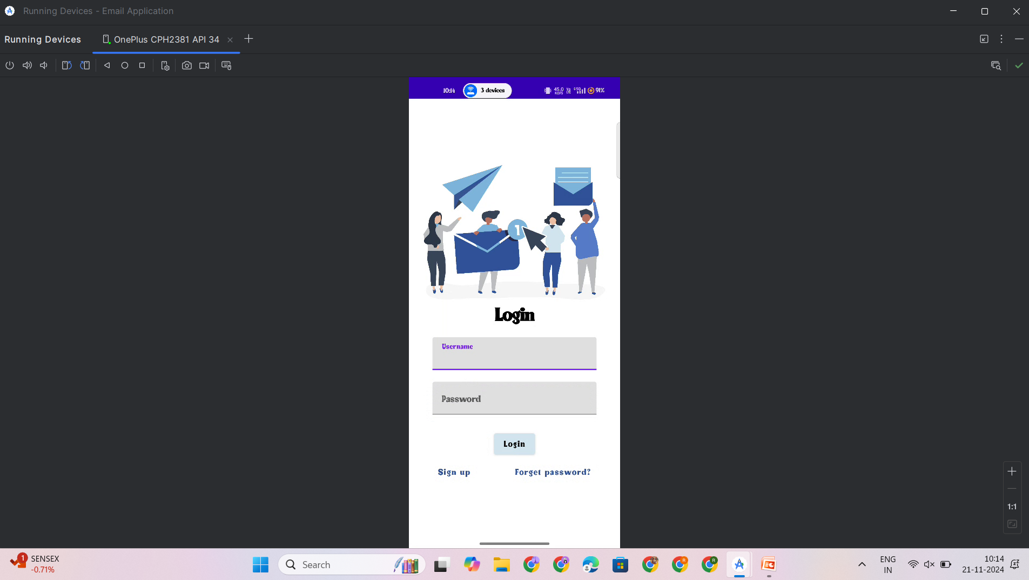
OUTPUT:

Slide 17
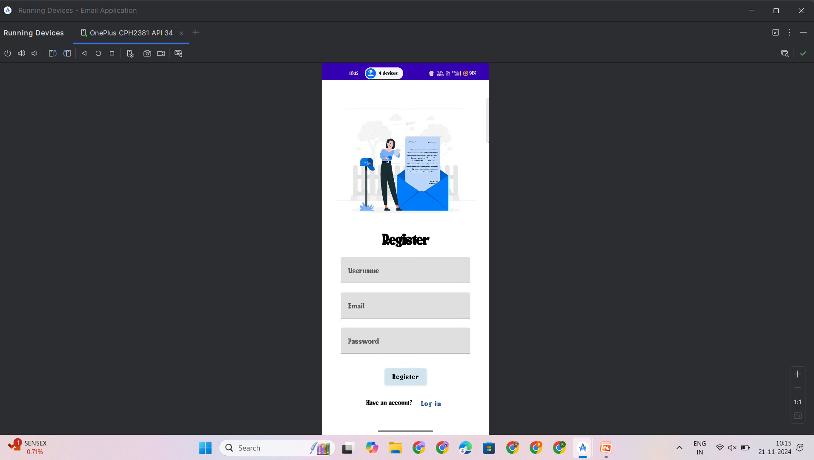

Slide 18
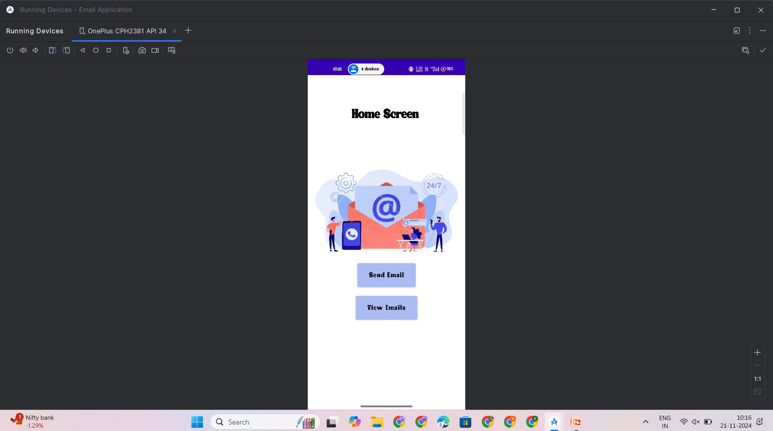

Slide 19
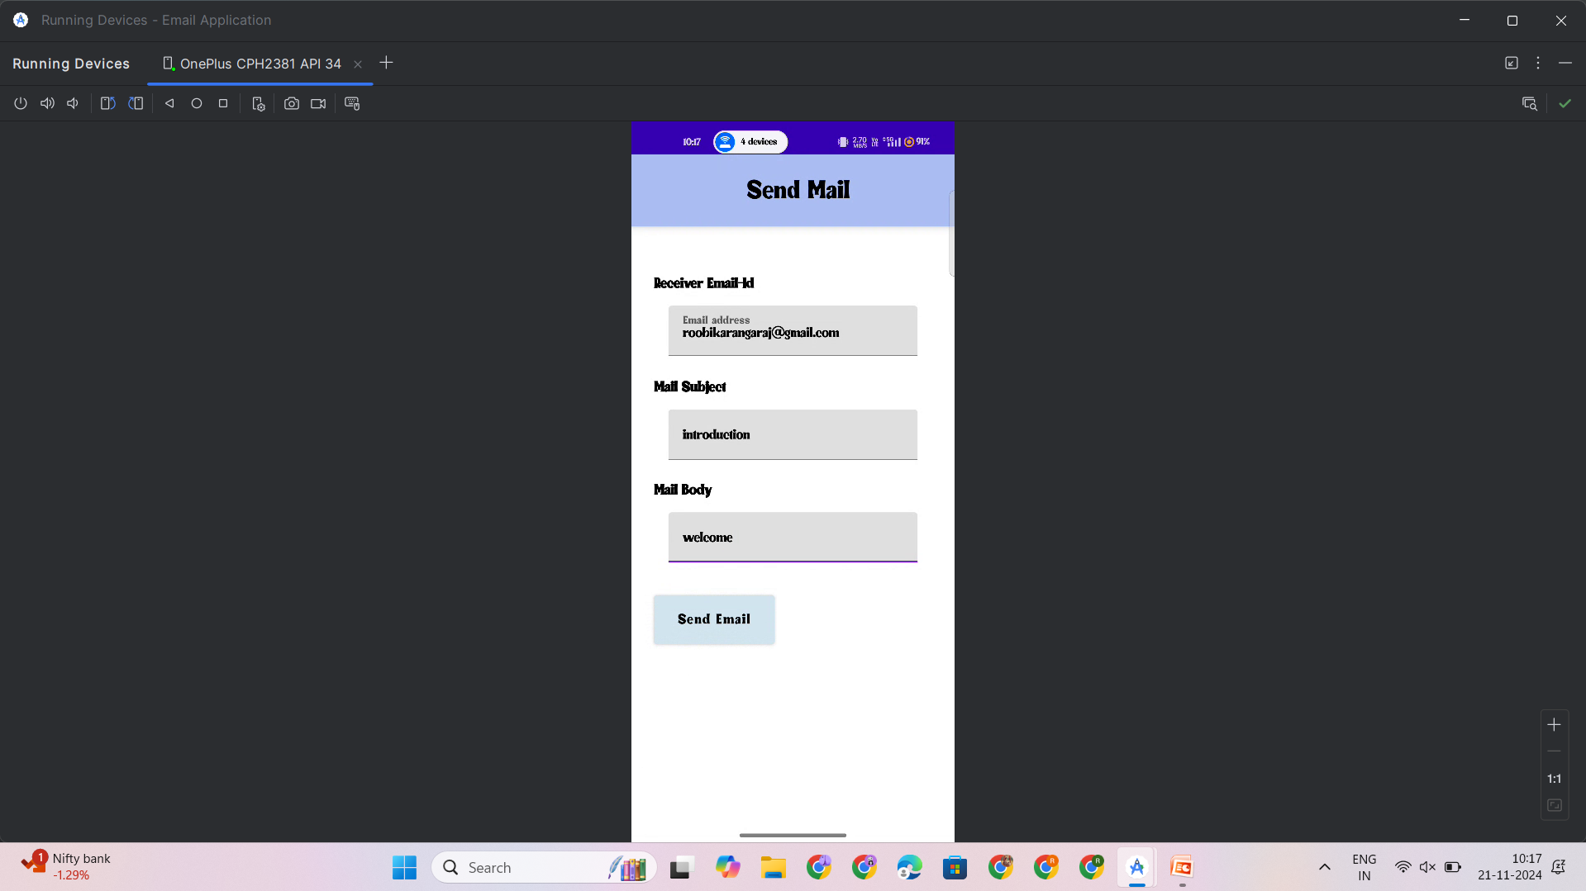

Slide 20
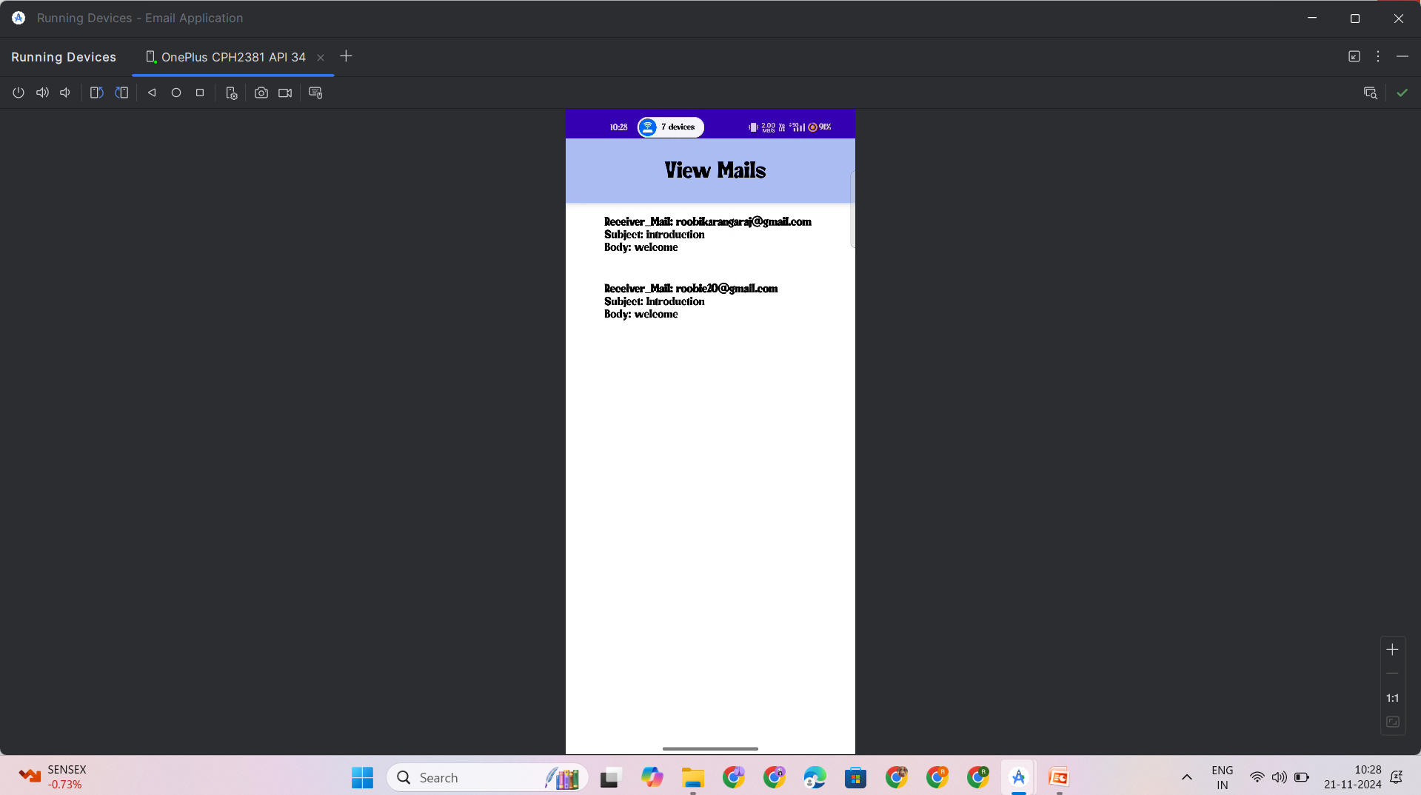

Slide 21

Demo Link:

